Slide 1
What is Inheritance In Java?
momedaram

Slide 2
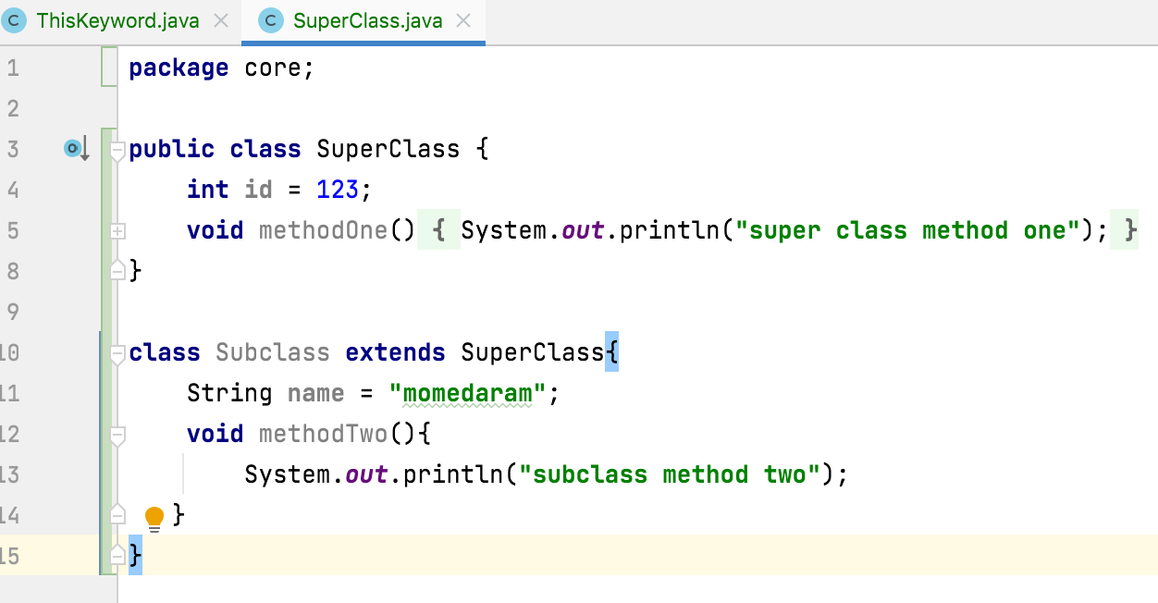
Inheritance in Java
The process of creating a child class from existing class.
Is used to add additional functionalities to the existing class
every class is a sub class of java.lang.Object class
Is implemented by using extends keyword

Slide 3
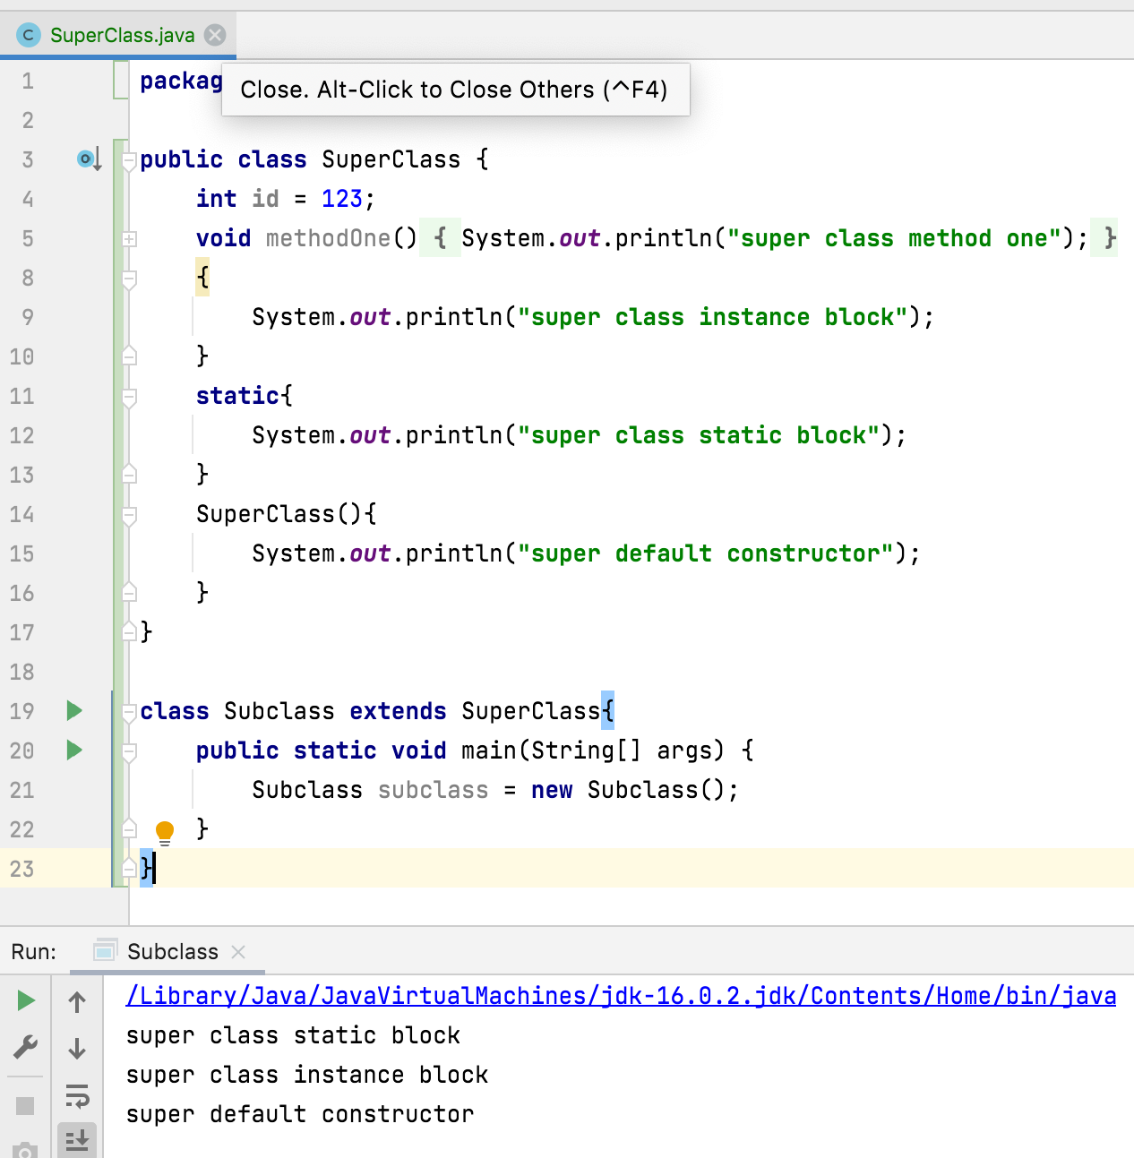
Constructors, SIB and IIB of super class will not be inheriting to its sub class. But they are executed while creating an object to sub class.

Slide 4
private : Private members can not be inherited to sub class.
Default : Default members can be inherited to sub class within package.
protected : protected members can be inherited to any sub class but usage of protected member is limited within package.
public : public members are inherited to all sub classes.
Let's see with examples…

Slide 5
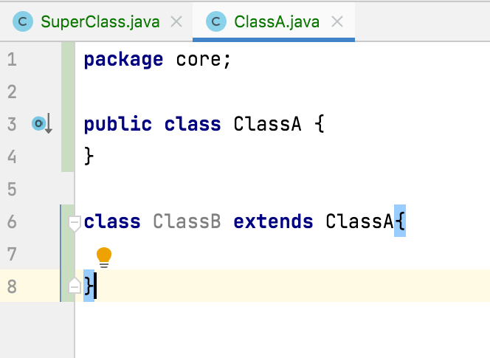
Types of Inheritance
Single Inheritance : One class is extended by only one class

Slide 6
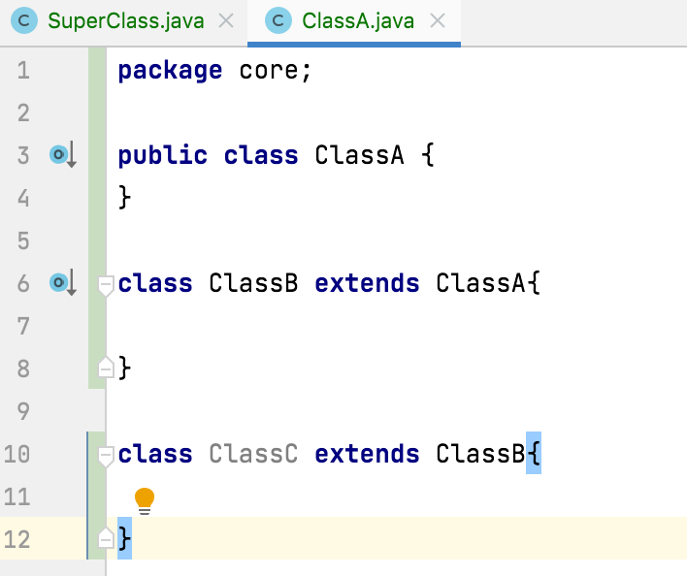
Types of Inheritance
Multilevel Inheritance : One class is extended by a class and that class is extended by another class thus forming chain of inheritance.

Slide 7
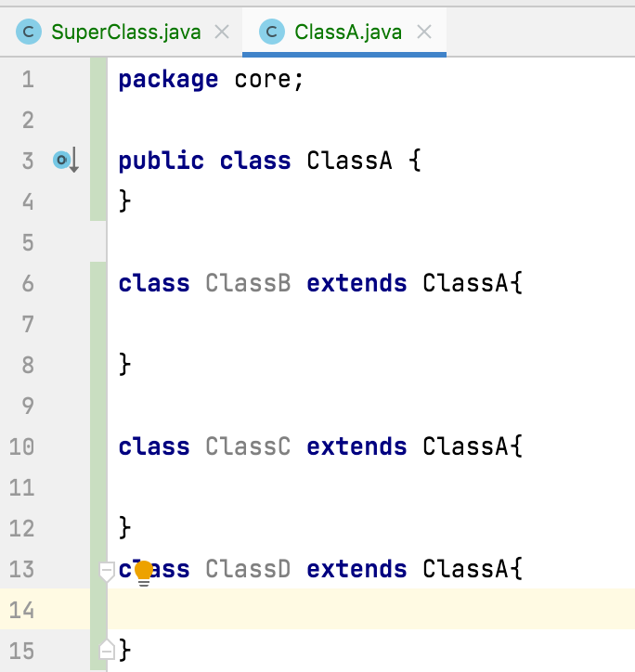
Types of Inheritance
Hierarchical Inheritance : One class is extended by many class

Slide 8
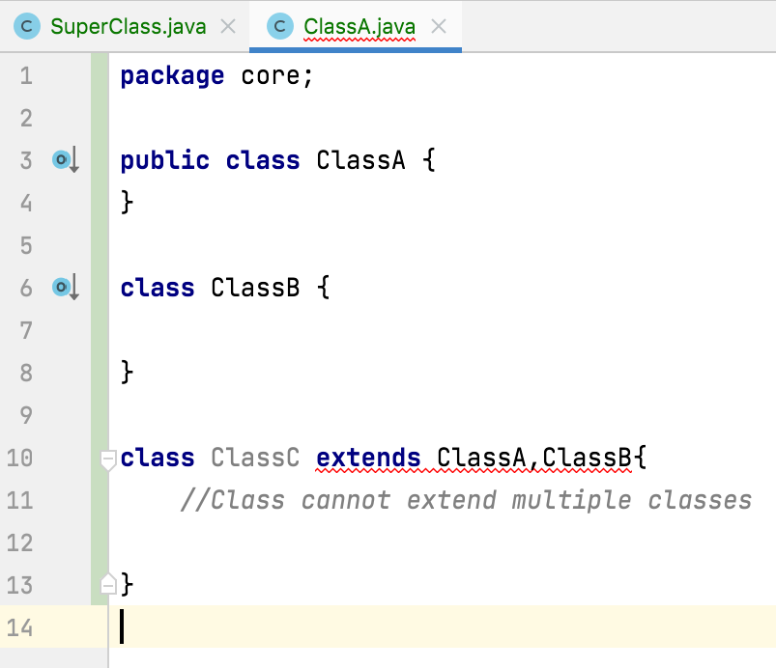
Types of Inheritance
Multiple Inheritance : One class extends more than one class

Slide 9
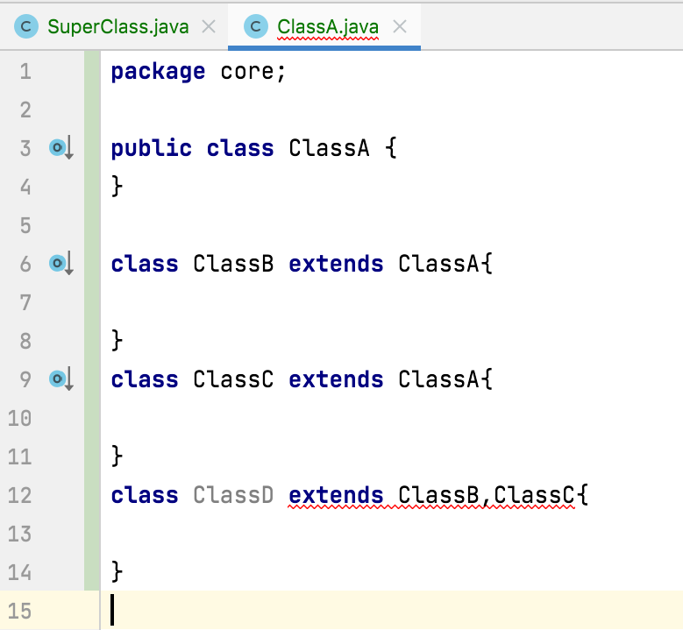
Types of Inheritance
Hybrid Inheritance: combination of multilevel and multiple inheritance

Slide 10
Thank You !
momedaram

